Slide 1
DIGITAL DESIGN & COMPUTER ARCHITECTURE
Design & Simulation of a Digital Data
Transmission Error-Detection System
Using XOR Logic
BINARY & HEX DATA
LOGISIM BLACK-BOX DESIGN
JAVA SOFTWARE MODEL

Slide 2
01
Why It Matters & Black-Box Thinking
Top-Down Design: System architecture is built using high-level "black-box" components first, deferring internal gate-level details for later modules.
The Noise Problem: Physical memory and transmission wiring are constantly exposed to environmental electrical noise.
Bit-Flip Vulnerability: Random electrical interference can silently flip binary bits, corrupting critical instructions or data values.
Proactive Prevention: Errors must be detected and flagged at the hardware level before any processed information can be trusted.
XOR-Centric Logic: System detection relies entirely on the foundational two-input, one-output behavior of the XOR gate.
2 / 10

Slide 3
02
Foundations: Binary, Hex & XOR
MAPS TO: READING THE MACHINE & THE DATAPATH AS BLACK BOXES
Data as Bits
XOR as a Black Box
Binary Foundation: Systems process information as raw 8-bit patterns (e.g., 1010 1101).
Hex Shorthand: Hexadecimal notation (AD) serves as a compact, human-readable translation of long binary strings.
Context Agnostic: Parity generation operates purely on structural bit patterns, completely independent of data types or signed formats (like two's complement).
Module 1 treats the ALU and register file as black boxes — used by what they do, not how they're wired inside. We treat XOR the same way.
A | B | A ⊕ B
0 | 0 | 0
0 | 1 | 1
1 | 0 | 1
1 | 1 | 0
Decimal | Binary (D7…D0) | Hex
173 | 1010 1101 | AD
3 / 10

Slide 4
03
Parity Design Rule
MAPS TO: INSTRUCTION FORMATS — FIELDS YOU DECODE
GENERATOR RULE
CHECKER RULE
XOR every data bit together, D0 through D7. Append the result as one extra bit — the parity field — onto the word before it's sent.
XOR every received bit, data and parity together. A result of 0 means the fields are still consistent (OK); a 1 flags a mismatch (ERROR).
Same idea as an instruction's opcode / register / immediate fields: our word has fields too — a data field and a check field — and the receiver decodes them the same way it would decode an instruction.
The generator and checker are then connected: Data → Generator → Channel (may add noise) → Checker → Error Flag
4 / 10

Slide 5
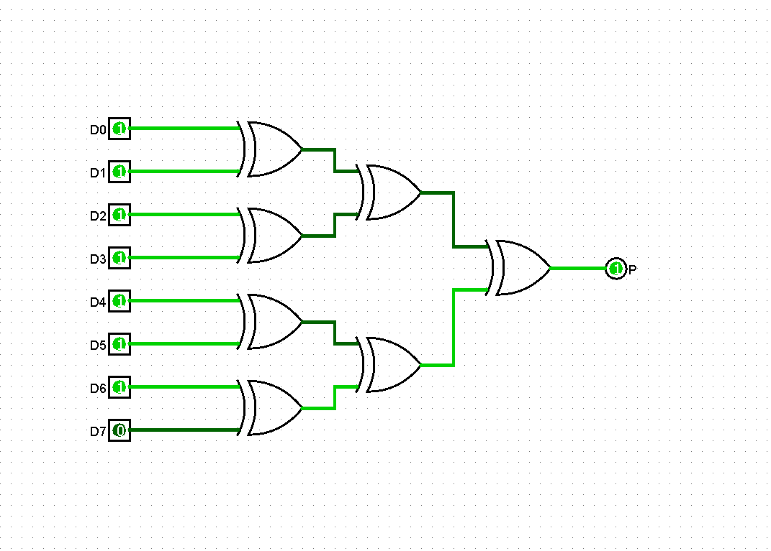
04
Logisim Design — Parity Generator
MAPS TO: THE VISUAL SIMULATOR — LOGISIM / DIGITAL
Eight data bits, D0 through D7, enter on the left — the same eight lines you'd wire up on a Logisim canvas.
Three stages of XOR blocks combine them pairwise, halving the signal count each stage: 8 → 4 → 2 → 1.
The final XOR's single output is the parity bit, P — the field appended to the word before transmission.
Because it's wired from smaller black boxes, the whole tree can be dropped into a bigger circuit as one black box — exactly what the checker does next.
built and simulated in Logisim
5 / 10

Slide 6
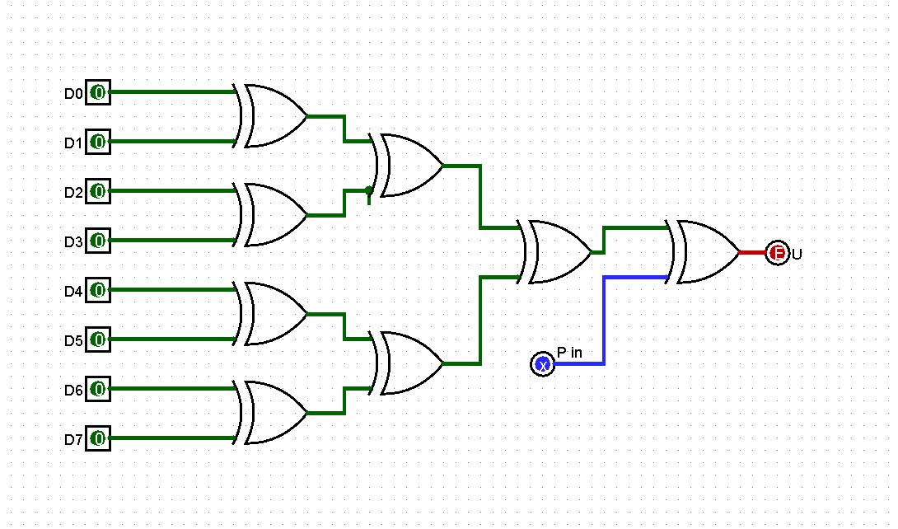
05
Logisim Design — Parity Checker
MAPS TO: CONNECTING BLACK BOXES INTO BIGGER ONES
The checker reuses the exact same parity-tree black box from the generator — no need to redesign it.
It runs that tree over the received data bits to recompute what the parity should be.
One more XOR gate compares that recomputed value against the parity bit that actually arrived with the data.
Output 0 means the two agree (OK); output 1 means they don't (ERROR) — the whole detector is just XOR blocks wired to XOR blocks.
6 / 10

Slide 7
06
From Circuit to Code: The Software Black Box
MAPS TO: HARDWARE VS SOFTWARE
Hardware and software are two ways of computing the same function — here is the same generator-and-checker logic as a deliberately basic Java program, using the built-in ^ (XOR) operator.
ParityCheck.java
public class ParityCheck {
public static void main(String[] args) {
// 8 data bits
int d0=1, d1=0, d2=1, d3=0, d4=1, d5=1, d6=0, d7=1;
int parity = d0^d1^d2^d3^d4^d5^d6^d7; // Generator
System.out.println("Parity bit: " + parity);
d3 = d3 ^ 1; // noise flips one bit
int check = parity^d0^d1^d2^d3^d4^d5^d6^d7; // Checker
System.out.println(check == 1 ? "ERROR detected!" : "No error (OK)");
}
}
7 / 10

Slide 8
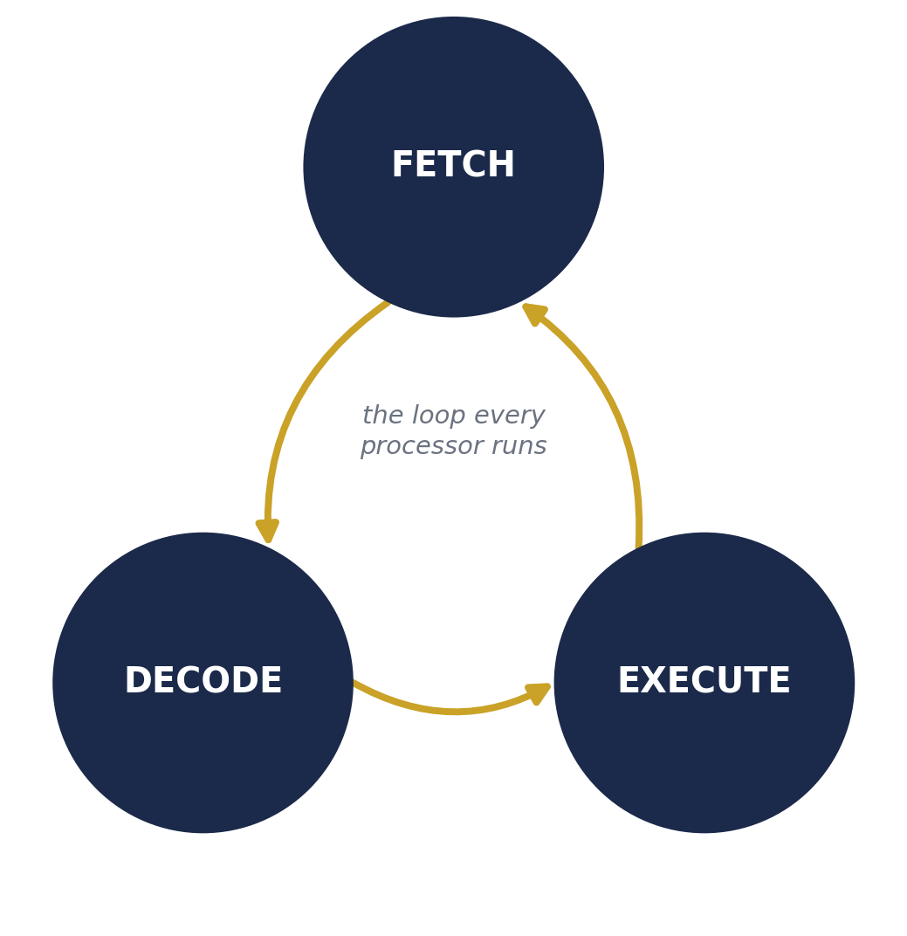
07
Mapping to the Fetch-Decode-Execute Cycle
MAPS TO: THE FETCH-DECODE-EXECUTE CYCLE
Every ^ in that Java line is one XOR operation — and on real hardware, each operation is one full trip around the fetch-decode-execute cycle traced on the working CPU in Module 1.
Fetch: the CPU reads the next instruction that performs the XOR from memory.
Decode: it works out which registers hold the two bits being combined.
Execute: the ALU black box — opened in a later module — produces the result, which is written back before the cycle repeats for the next ^.
8 / 10

Slide 9
08
Simulation Walkthrough
MAPS TO: RUN AND STEP THEM — OBSERVING BEHAVIOR
Case | Data sent (D0…D7) | P | Data received | Checker result
No error | 1 0 1 0 1 1 0 1 | 1 | 1 0 1 0 1 1 0 1 | OK
Single-bit error (D3 flips) | 1 0 1 0 1 1 0 1 | 1 | 1 0 1 1 1 1 0 1 | ERROR detected
Double-bit error (D3 & D5 flip) | 1 0 1 0 1 1 0 1 | 1 | 1 0 1 1 1 0 0 1 | OK — missed!
A single-bit flip always changes the count of 1s from even to odd, so the checker always catches it. Two flips can cancel out and slip through undetected — the well-known limitation of simple parity.
Cheap: one extra bit catches every single-bit (odd-count) error.
Limited: it can only flag an error, never correct it, and misses even-count flips.
9 / 10

Slide 10
Closing the Loop
Built a complete black box — data in, OK / ERROR out — before worrying about its internals, the same outside-in path Module 1 promises for the whole machine.
Composed a bigger black box (the checker) out of a smaller, already-tested one (the generator) — the same habit used to connect the PC, register file, ALU, and control unit.
Modeled the same function twice — once in Logisim, once in Java — a small, hands-on look at the hardware/software boundary.
Built and tracked with the same tools from Day One: Logisim/Digital for simulation, and Git for version control.
“One black box opened. Many more to go.”

